Slide 1

Title - Disaster Tweet Classification Using NLP
Subtitle - Enhancing Disaster Management with Machine Learning
Name of presenter – Mrs. Sapna Kharche

Slide 2
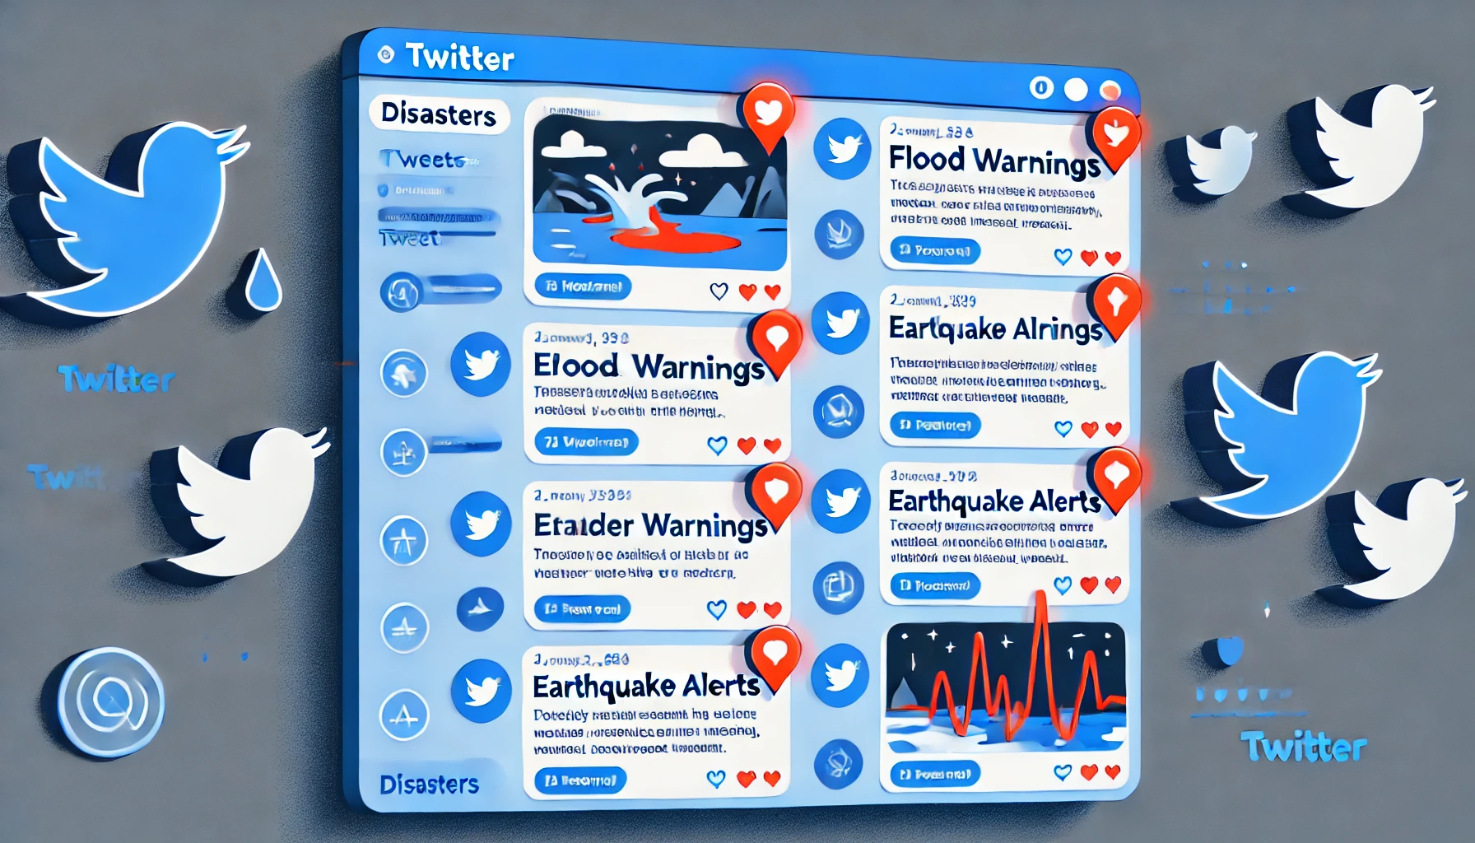
Project Overview
Twitter is a critical platform for sharing real-time information during emergencies.
The challenge lies in distinguishing genuine disaster tweets.
This project uses Natural Language Processing (NLP) and machine learning to classify tweets as disaster-related or non-disaster-related.
The application aims to support disaster relief agencies in efficient detection and response.

Slide 3

Problem Statement
During emergencies, timely identification of disaster-related information on social media can save lives.
Distinguishing relevant tweets is challenging due to:
Use of metaphors and slang.
Overlap in vocabulary between genuine and unrelated tweets.
Manual classification is impractical for large-scale data streams.

Slide 4
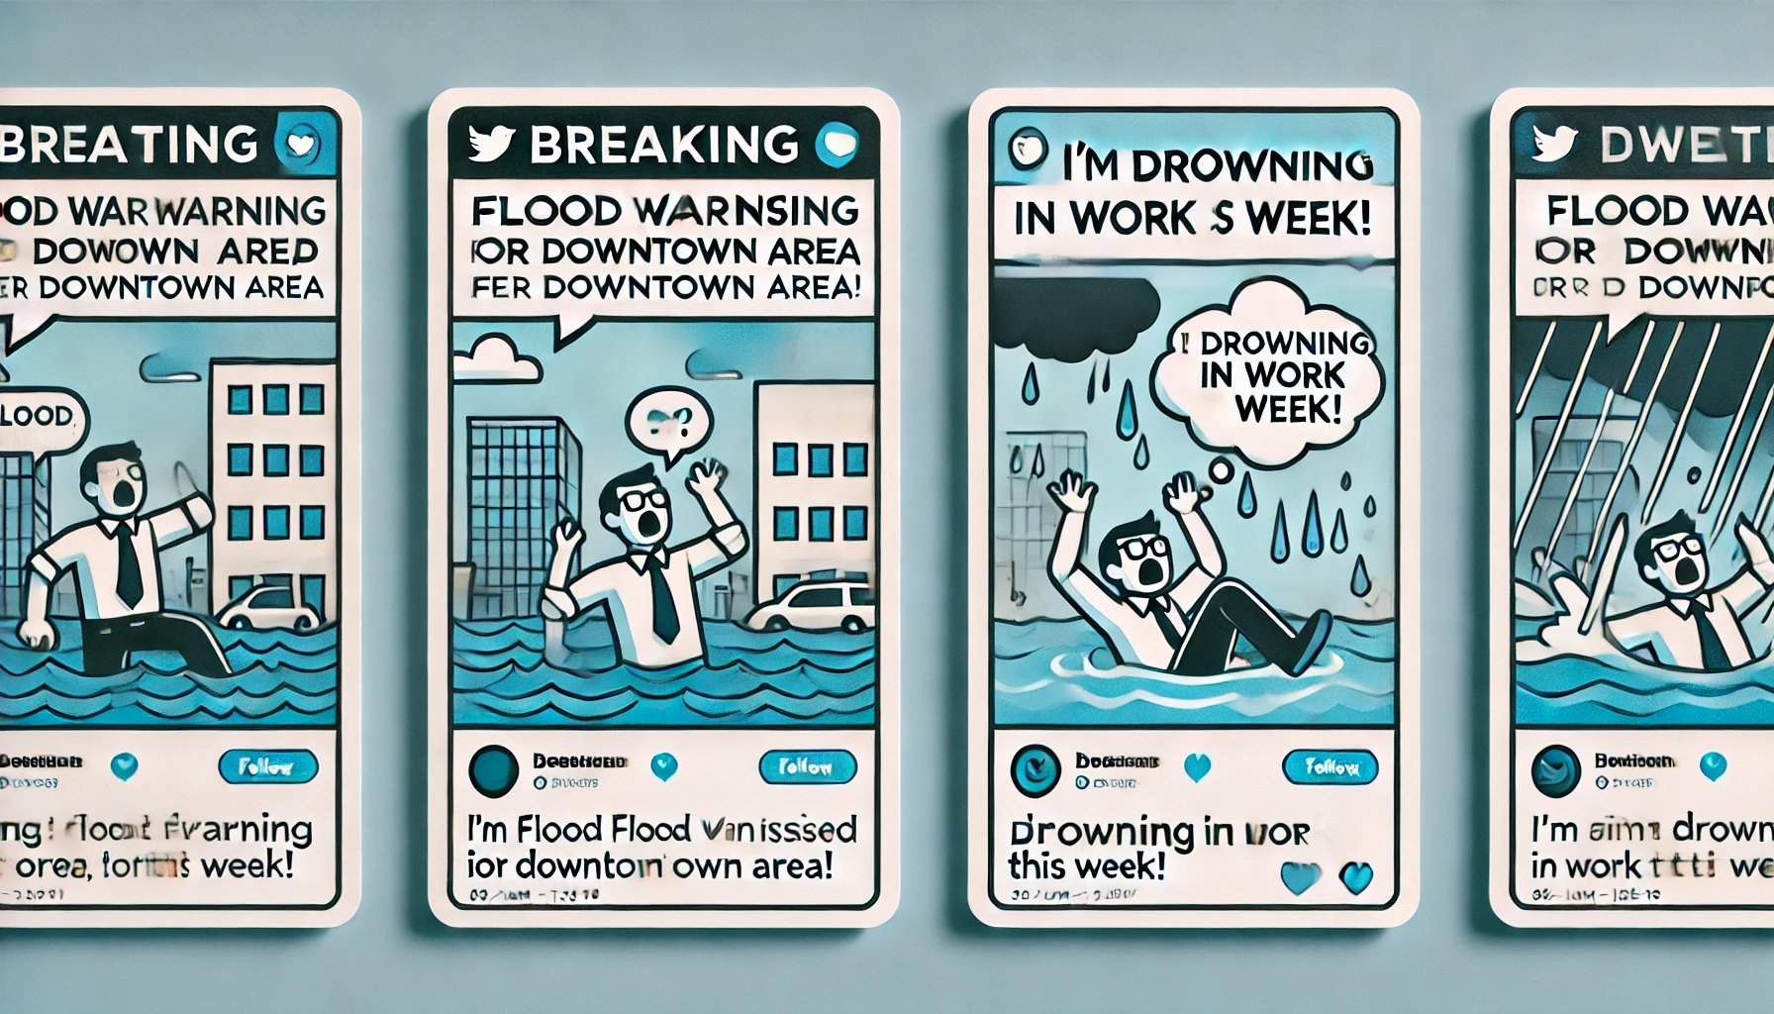
Solution
Build a scalable machine learning model to classify tweets in real-time.
Use NLP techniques to preprocess and analyze text data.
Deploy the model as a user-friendly web application for real-time predictions.

Slide 5

Methodology
Data Exploration and Preparation:
Load and clean a dataset of 10,000 labelled tweets.
Tokenize and preprocess text (remove URLs, hashtags, etc.).
Feature Engineering:
Use TF-IDF for text vectorization.
Explore features like tweet length and sentiment.
Model Selection and Training:
Train Logistic Regression and evaluate using cross-validation.

Slide 6
Key Features
Handles noisy, unstructured Twitter data effectively.
Incorporates advanced NLP techniques (e.g., TF-IDF vectorization).
Provides real-time predictions through a web-based interface.
Supports scalability for monitoring large-scale tweet streams.

Slide 7
Results and Achievements
Achieved an accuracy of 79% and an AUC score of 0.85.
Confusion matrix showed minimal false negatives, ensuring disaster tweets are not missed.

Slide 8

Challenges Faced
Dealing with noisy and ambiguous tweet data.
Handling variations in language, including abbreviations and slang.
Balancing model precision to minimize false alarms while ensuring true positives.

Slide 9
Conclusion
This project demonstrates the potential of NLP in disaster management.
The developed model efficiently classifies tweets, providing valuable support to relief organizations.
Future scope includes extending the application to other languages and improving handling of sarcasm and metaphor.

Slide 10

THANK YOU

